Slide 1
Modelling and Testing of Bifacial solar PV systems T24
RA1711002010024- A. Rahul Aravind
RA1711002010049- Prasanth Chowdary. Y
Under the guidance of
Mr. Joji Johnson

Slide 2
Contents
Abstract
Objective
Methodology
Model specifications
Project setup
Mathematical Data Analysis
Simulation Results and Graphs
Conclusion and Optimal conditions taken from simulation
References

Slide 3
Abstract
Bifacial photovoltaic system produces solar power from both sides of the panel by absorbing sunlight from the sun directly and also by the means of reflected and diffused rays that fall on both the front and rear side of the panel. Bifacial solar modules can be installed both in vertical and horizontal orientation with each offering different benefits. Bifacial solar modules offer an interesting price/performance ratio. Much work has been focused on the tilt angle, orientation and directing the ground albedo to the panel. In this paper, we will test the panel by increasing the height in two different settings: 1 meter and 1.5 meter. By this we increase the overall efficiency of solar panel. We will see the optimal parameters and conditions for the most efficient installation and testing for the given location.

Slide 4
Objective
To develop a prototype of Bifacial photovoltaic system with optimized performance conditions for the heights at 1 meter and 1.5 meter.
To Mathematically solve and get the results for the same setup models.
To simulate an system for a given power rating and find the efficiency and output.
To compare the performance parameter between the simulation and theoretical model.
Validate the model according to prototype parameter.

Slide 5
Methodology
Construct the system in a viable position and tabulate the values of the given system for 3 days.
Increase the height of the panel and record the values of the system to get the results for the next 3 days and infer the difference due to height.
This process is carried out on the mathematical model of the bifacial panel and the performance is compared to that of the actual result.
The simulation for a full system is carried out and the best conditions for the real world is selected from the simulation.
Comparative study is done for the systems and analysed.

Slide 6
Model Specifications
Module | 195W
Irradiance (mW/cm²) | 100
Vmp (V) | 20.295
Voc (V) | 24.3804
F.F | 79.24
Model Area (cm²) | 9875.25
Imp (A) | 9.7611
Isc (A) | 10.2541
Pmp (W) | 198.1019
Module efficiency (%) | 20.56

Slide 7
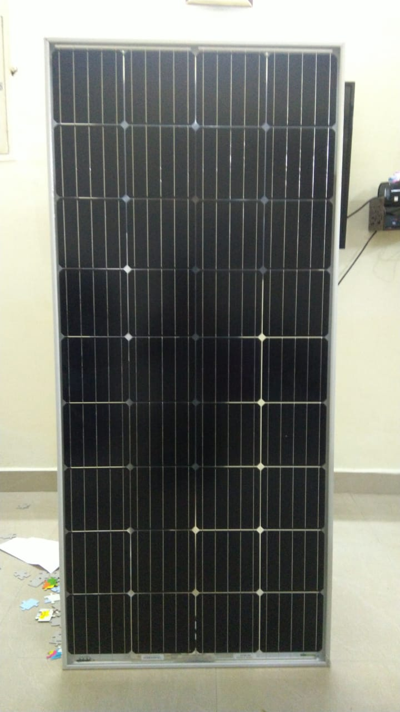
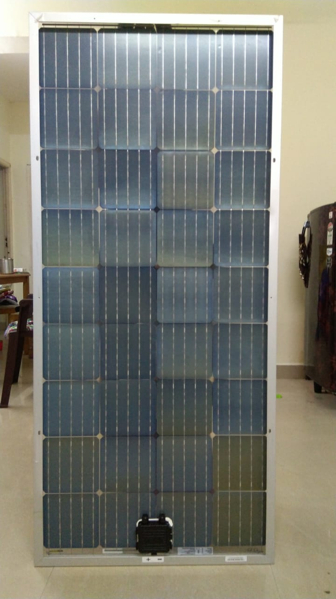
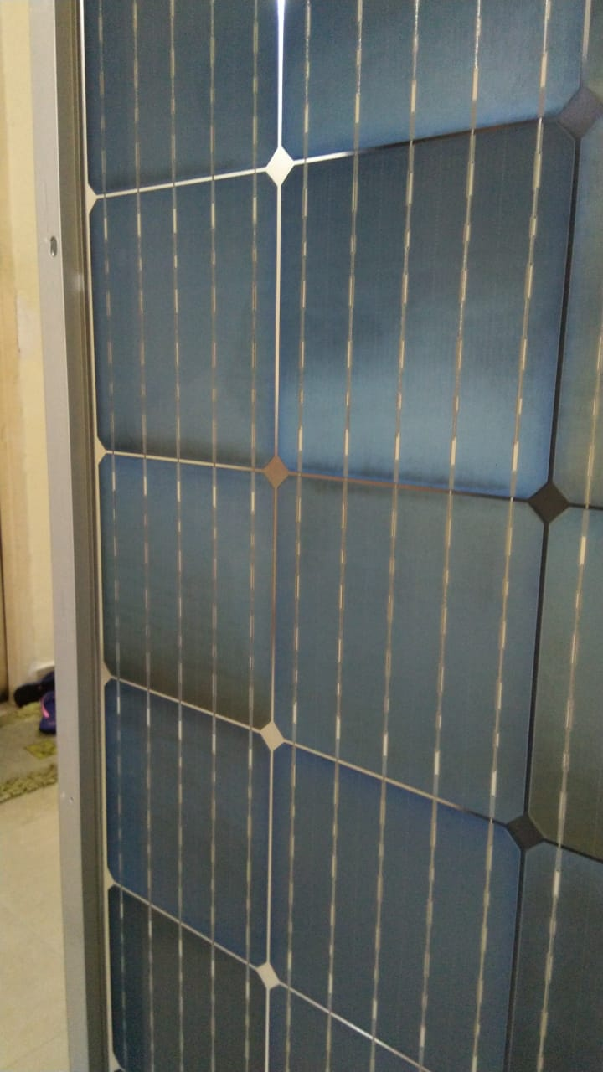
Project Setup (Solar panel)
FRONT SIDE
REAR SIDE
MODULE CLOSE-UP

Slide 8
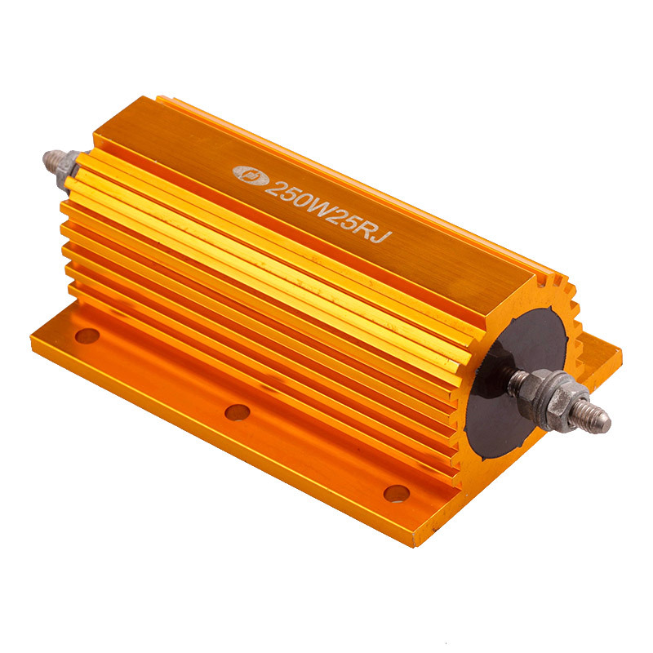
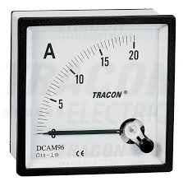
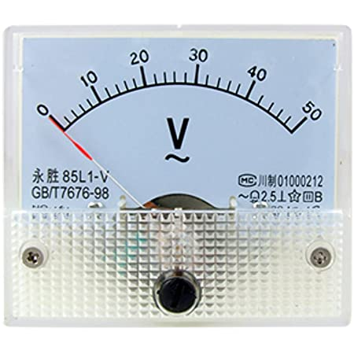
Project Setup (Instruments)
R= V/I = (20.295/9.7611) = 2.097 ohms
Ammeter with at least 20A measurement
Voltmeter with at least 20V measurement

Slide 9
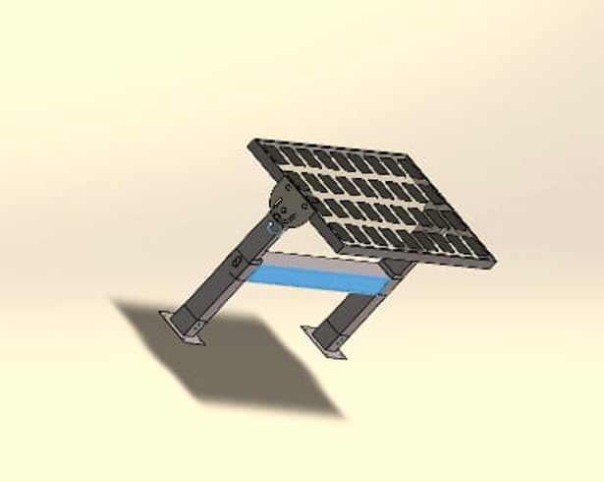
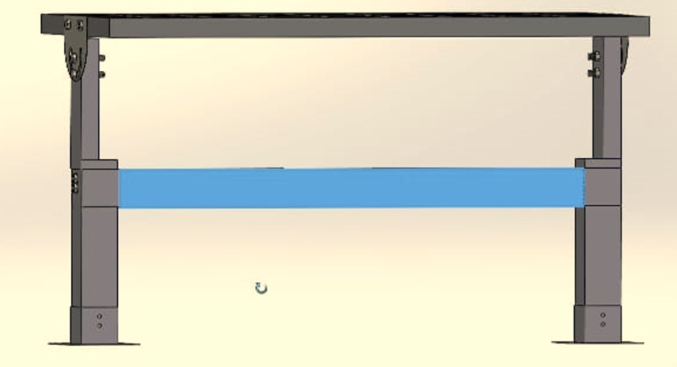
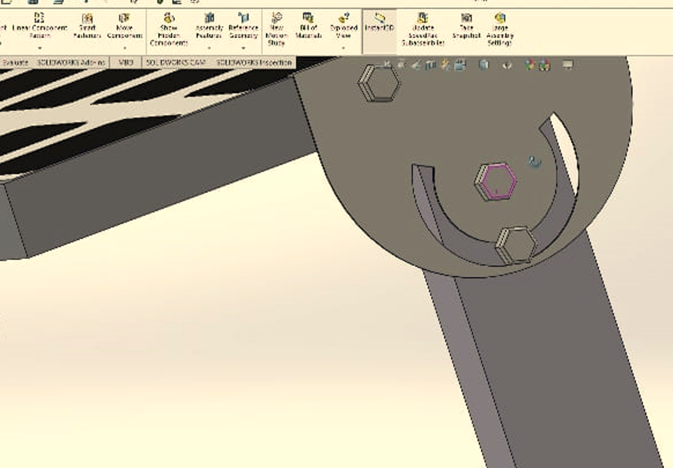
Project Setup (Support Structure)

Slide 10
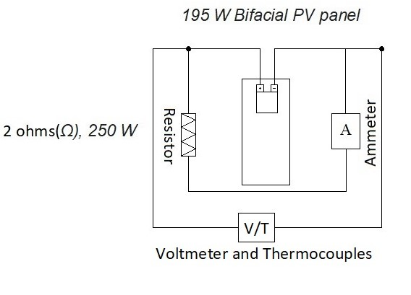
Project Setup (Layout)
The circuit is connected as showing.
Ammeter is connected in series with the load and the negative of PV panel
The voltmeter is connected in parallel with the load and negative of the panel
Thus they show the values of the same.

Slide 11
Mathematical Data Analysis
Using the following system, we will find Voltage(V), Temperature(T) and Current (A) at 8AM, 10AM, 12PM, 2PM, 4PM.
With which we are able to find the power generated by the panel at those timings. Using the formula P= V x I (watts).
This method will be carried out for both settings at 1 meter and 1.5 meters setups.
The results will be compared later.

Slide 12
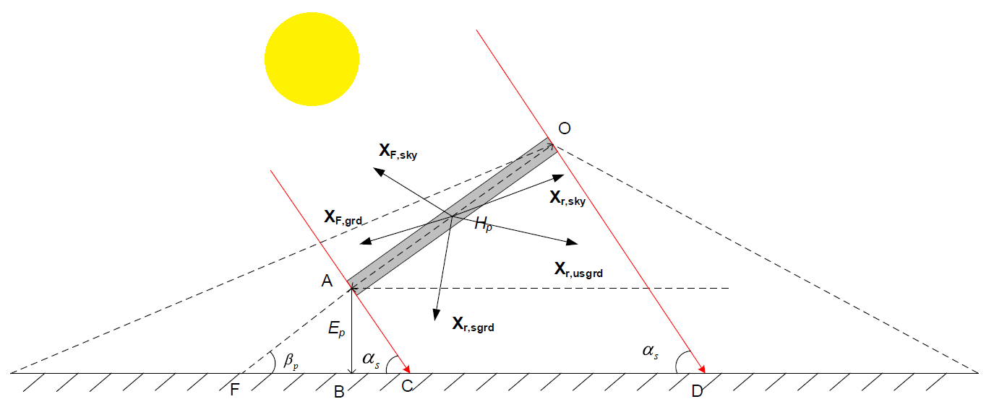
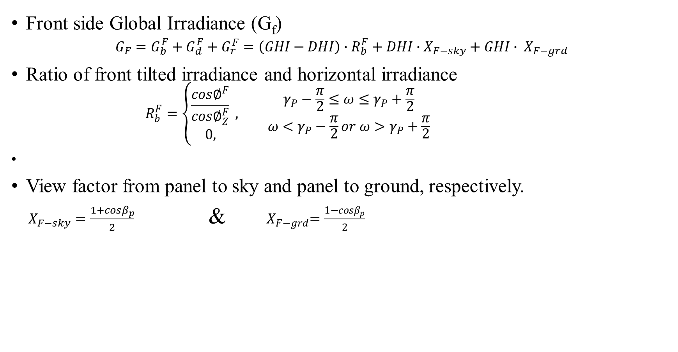
Mathematical Data Analysis
Front side Global Irradiance (G_{f})
$$G_{F}=G_{b}^{F}+G_{d}^{F}+G_{r}^{F}=\left(GHI−DHI\right)∙R_{b}^{F}+DHI∙X_{F−sky}+GHI∙ X_{F−grd}$$
Ratio of front tilted irradiance and horizontal irradiance
$$R_{b}^{F}=\left\{\begin{aligned}\frac{cos∅^{F}}{cos∅_{Z}^{F}} \\ 0,\end{aligned}\right. , {γ_{P}−\frac{π}{2}≤ω≤γ_{P}+\frac{π}{2} \atop ω<γ_{P}−\frac{π}{2}or ω>γ_{P}+\frac{π}{2}}$$
View factor from panel to sky and panel to ground, respectively.
$X_{F−sky}=\frac{1+cosβ_{p}}{2}$ & ${ X}_{F−grd}=\frac{1−cosβ_{p}}{2}$

Slide 13
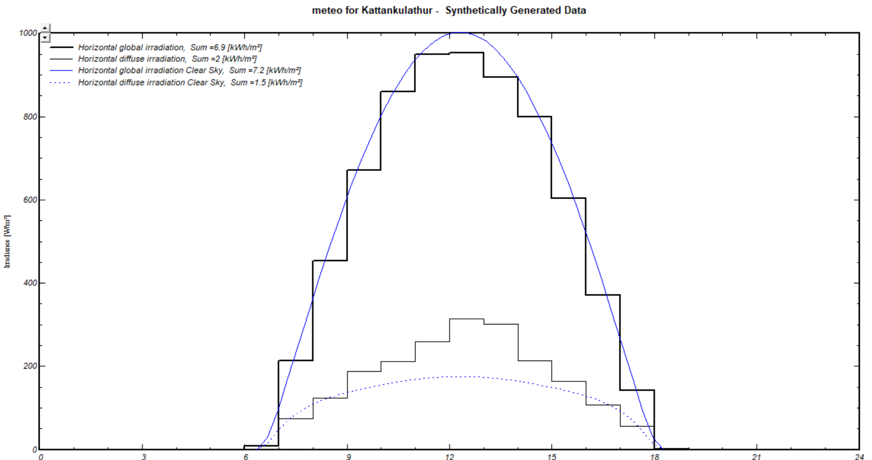
Mathematical Data Analysis
Graph for the Global and diffused horizontal radiation using PVsyst (7.2)
TIME | DHI | GHI
8AM | 74kW/m² | 215kW/m²
10AM | 190kW/m² | 680kW/m²
12PM | 260kW/m² | 940kW/m²
2PM | 215kW/m² | 900kW/m²
4PM | 110kW/m² | 600kW/m²

Slide 14
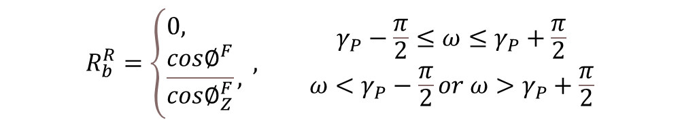

Mathematical Data Analysis
Rear side Global irradiance (G_{r})
Ratio of rear tilted irradiance and horizontal irradiance
View factor from panel to sky
$$G_{F}=G_{b}^{R}+G_{d}^{R}+G_{r}^{R}=\left(GHI−DHI\right)∙R_{b}^{R}+DHI∙X_{R−sky}+GHI∙ρ_{P}∙ X_{R−usgrd}+DHI∙GHI∙ρ_{P}∙ X_{R−sgrd}$$
$$R_{b}^{R}=\left\{\begin{aligned}&0, \\ &\frac{cos∅^{F}}{cos∅_{Z}^{F}},\end{aligned}\right. , {γ_{P}−\frac{π}{2}≤ω≤γ_{P}+\frac{π}{2} \atop ω<γ_{P}−\frac{π}{2}or ω>γ_{P}+\frac{π}{2}}$$
$$X_{R−sky}=\frac{1−cosβ_{p}}{2}$$

Slide 15



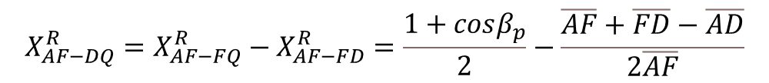


Mathematical Data Analysis
View factor of rear side to unshaded ground X_{R-usgrd}
$$X_{R−usgrd}= X_{R−DQ}+X_{R−CF}$$
$$X_{R−DQ}=\frac{X_{OF−DQ}^{R}∙\overline{OF}−X_{AF−DQ}^{R}∙\overline{AF}}{\overline{OA}}$$
$$X_{R−CF}=\frac{X_{OF−CF}^{R}∙\overline{OF}−X_{AF−CF}^{R}∙\overline{AF}}{\overline{OA}}$$
$$X_{OF−DQ}^{R}=X_{OF−FQ}^{R}−X_{OF−FD}^{R}=\frac{1+cosβ_{p}}{2}−\frac{\overline{OF}+\overline{FD}−\overline{OD}}{2\overline{OF}}$$
$$X_{AF−DQ}^{R}=X_{AF−FQ}^{R}−X_{AF−FD}^{R}=\frac{1+cosβ_{p}}{2}−\frac{\overline{AF}+\overline{FD}−\overline{AD}}{2\overline{AF}}$$
$$X_{OF−CF}^{R}= \frac{\overline{OF}+\overline{CF}−\overline{OC}}{2\overline{OF}}$$
$$X_{AF−CF}^{R}= \frac{\overline{AF}+\overline{CF}−\overline{AC}}{2\overline{AF}}$$

Slide 16


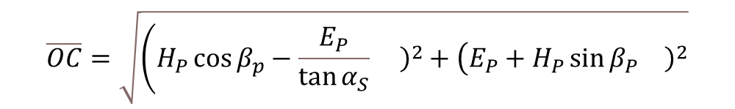
Mathematical Data Analysis
$$AF=\frac{E_{P}}{{\sin{β}}_{P}}; \overline{OD}=\sqrt{{\left(H\right.}_{P}\cos{β_{P}}−\frac{E_{P}\cos{α_{S}}+H_{P}\sin\left(α_{S}+β_{P}{\left.\right)}^{2}+\left(E_{P}+H_{P}\sin{β_{P}{\left.\right)}^{2}}\right.\right.}{\sin{α_{S}}}}$$
View factor of rear side to shaded ground X_{R-sgrd}
$$AC=\frac{E_{P}}{{\sin{α}}_{S}}; \overline{CF}=E_{P}\left(\frac{1}{\tan{α_{S}}}+\frac{1}{\tan{β_{P}}}\right); \overline{FD}=\frac{H_{P}}{\sin{α_{S}}}\sin\left(α_{S}+β_{P}\right)+\frac{H_{P}}{\tan{β_{P}}}+\frac{H_{P}}{\tan{α_{S}}};$$
$$\overline{OC}=\sqrt{\left(H_{P}\cos{β_{p}−\frac{E_{P}}{{\tan{α}}_{S}}{\left.\right)}^{2}+\left(E_{P}+H_{P}\sin{β_{P}{\left.\right)}^{2}}\right.}\right.}$$
$$\overline{AD}= \sqrt{{\left(\frac{E_{P}\cos{α_{S}+}H_{P}\sin\left(α_{S}+β_{P}\right)}{\sin{α_{S}}}\right)}^{2}}+{E_{P}}^{2}$$
$$X_{R−sgrd}= \frac{\overline{OC}+\overline{AD}−\left(\overline{AC}+\overline{OD}\right)}{2\overline{OA}}$$

Slide 17
Mathematical Data Analysis
TIME | Front side Global irradiance( W/m²) | Rear side Global irradiance( W/m²) | Rear side Global irradiance( W/m²)
 |  | (1 meter height) | (1.5 meter height)
8:00 AM | 190.1 | 81.463 | 165.908
10:00 AM | 1035 | 290.035 | 311.93
12:00 PM | 1383 | 402.34 | 435.36
2:00 PM | 753.1 | 322.55 | 342.68
4:00 PM | 234.6 | 207.12 | 271.29

Slide 18
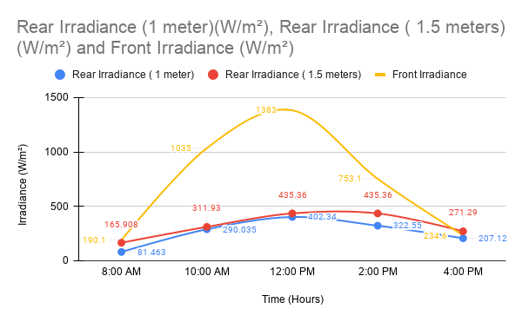
Mathematical Data Analysis

Slide 19
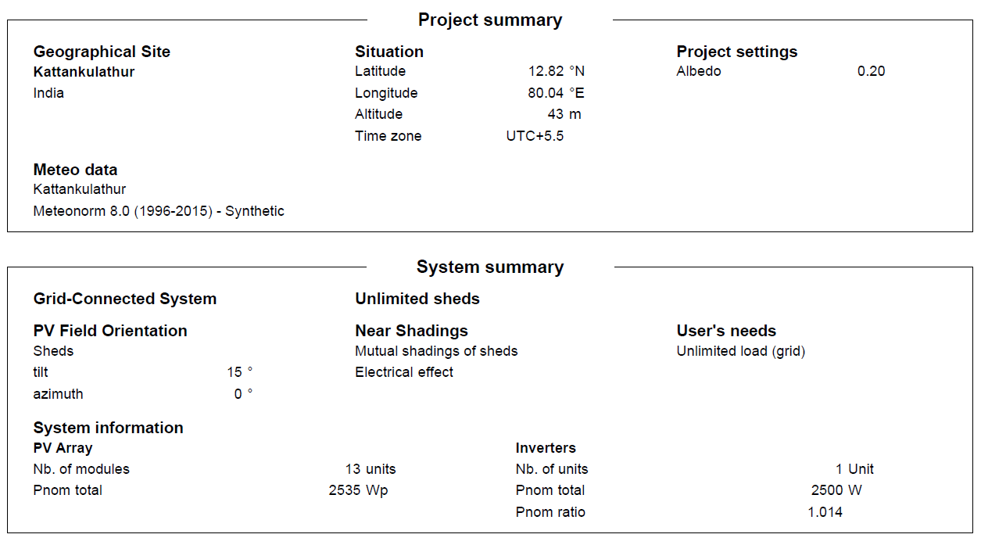
Simulation Results and Graphs
All simulation settings and conditions including losses

Slide 20
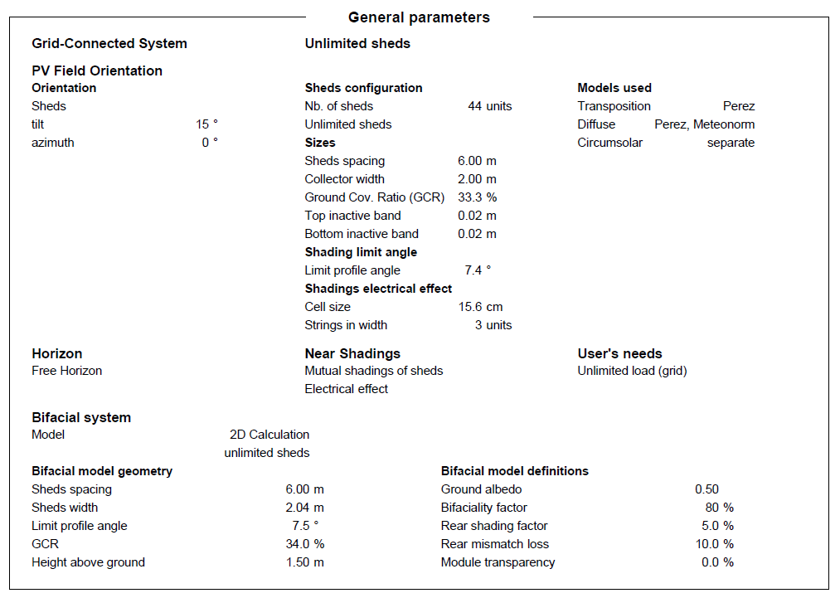
Simulation Results and Graphs

Slide 21
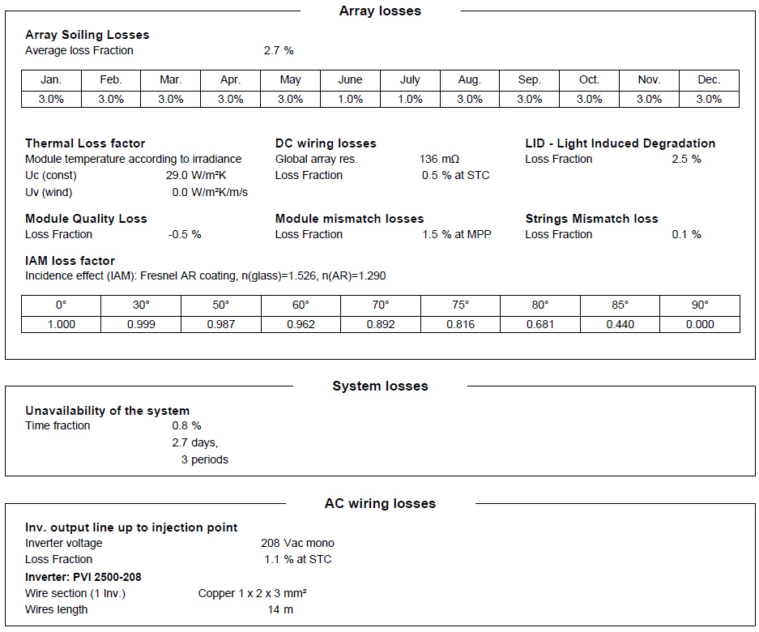
Simulation Results and Graphs

Slide 22
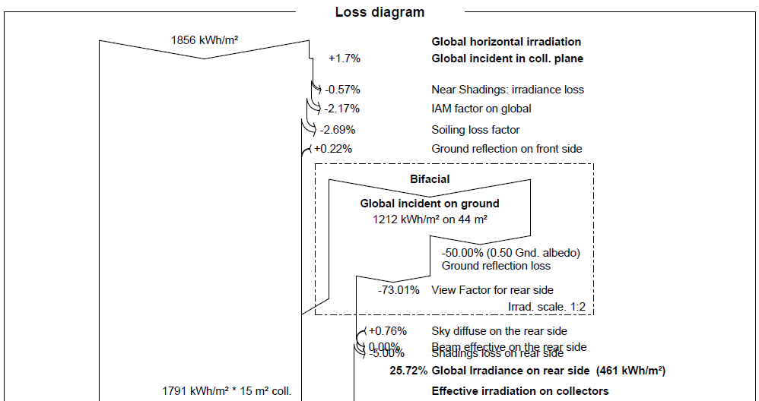
Simulation Results and Graphs

Slide 23
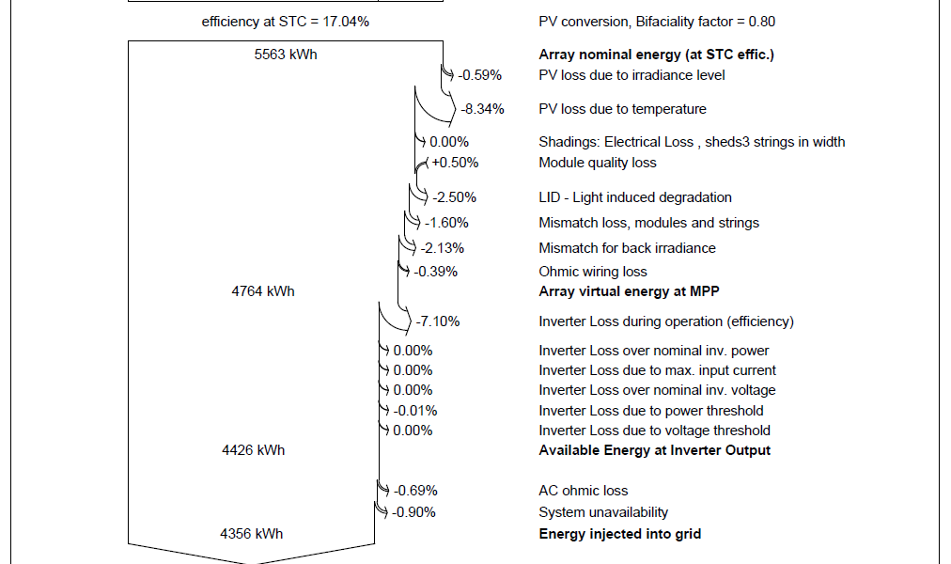
Simulation Results and Graphs

Slide 24
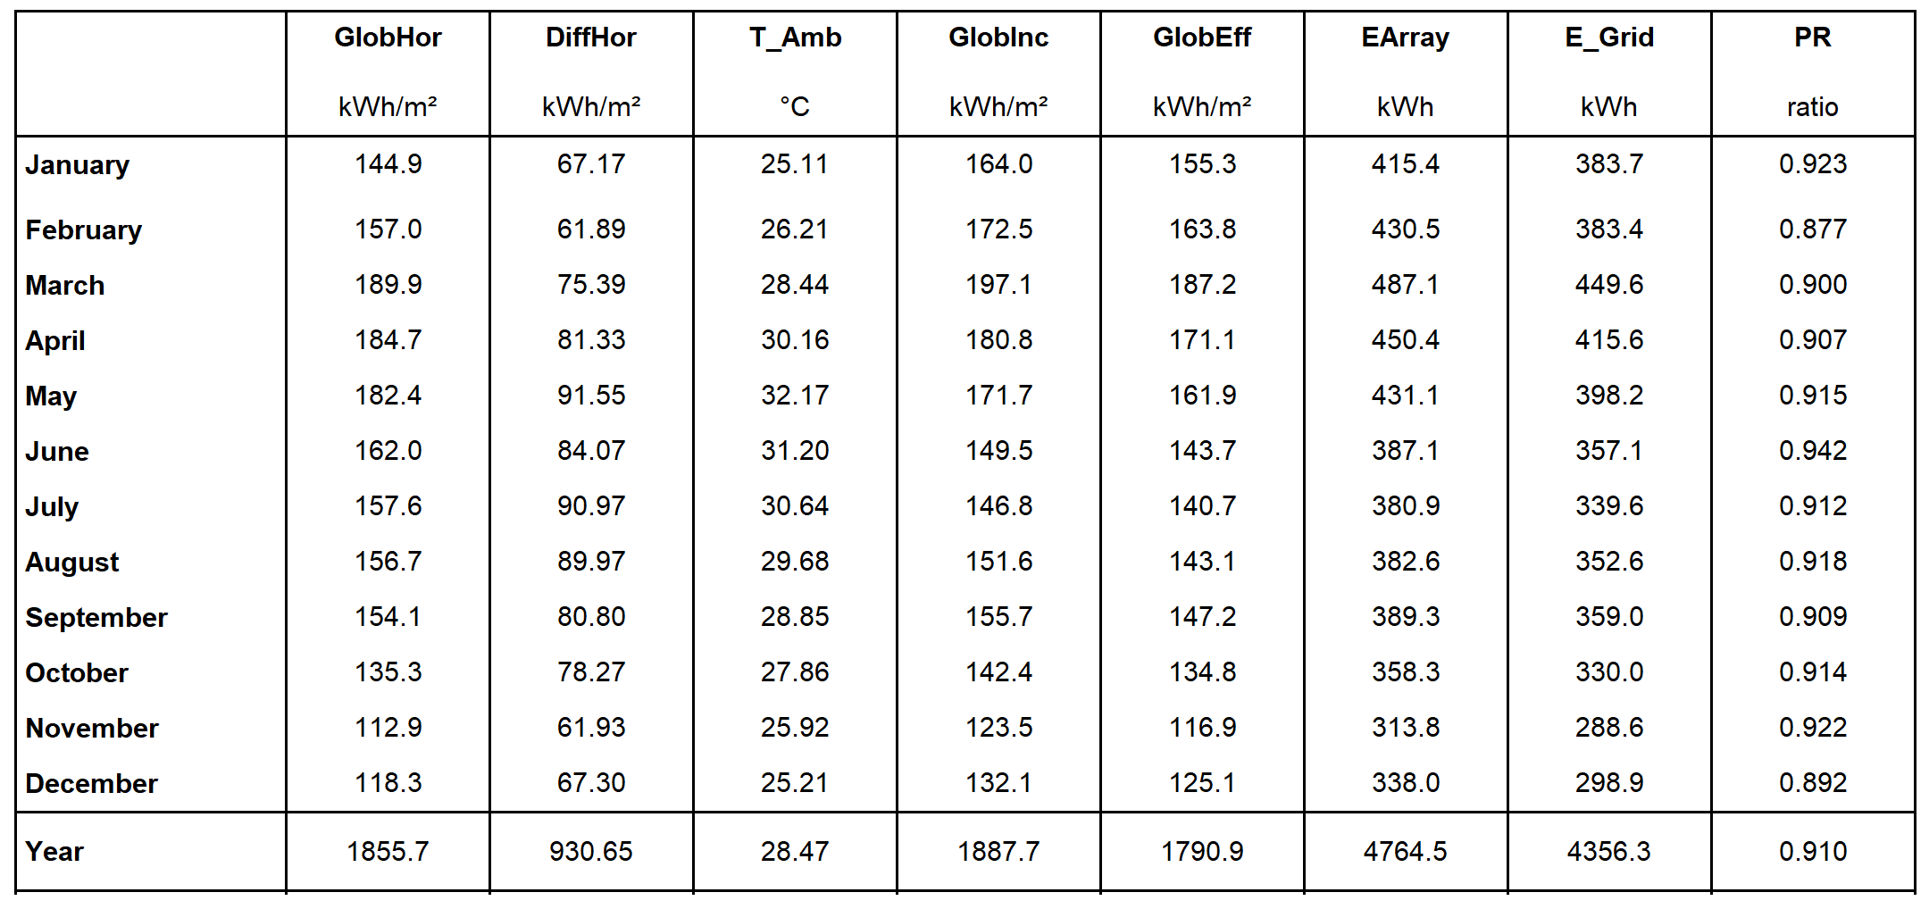
Simulation Results and Graphs

Slide 25
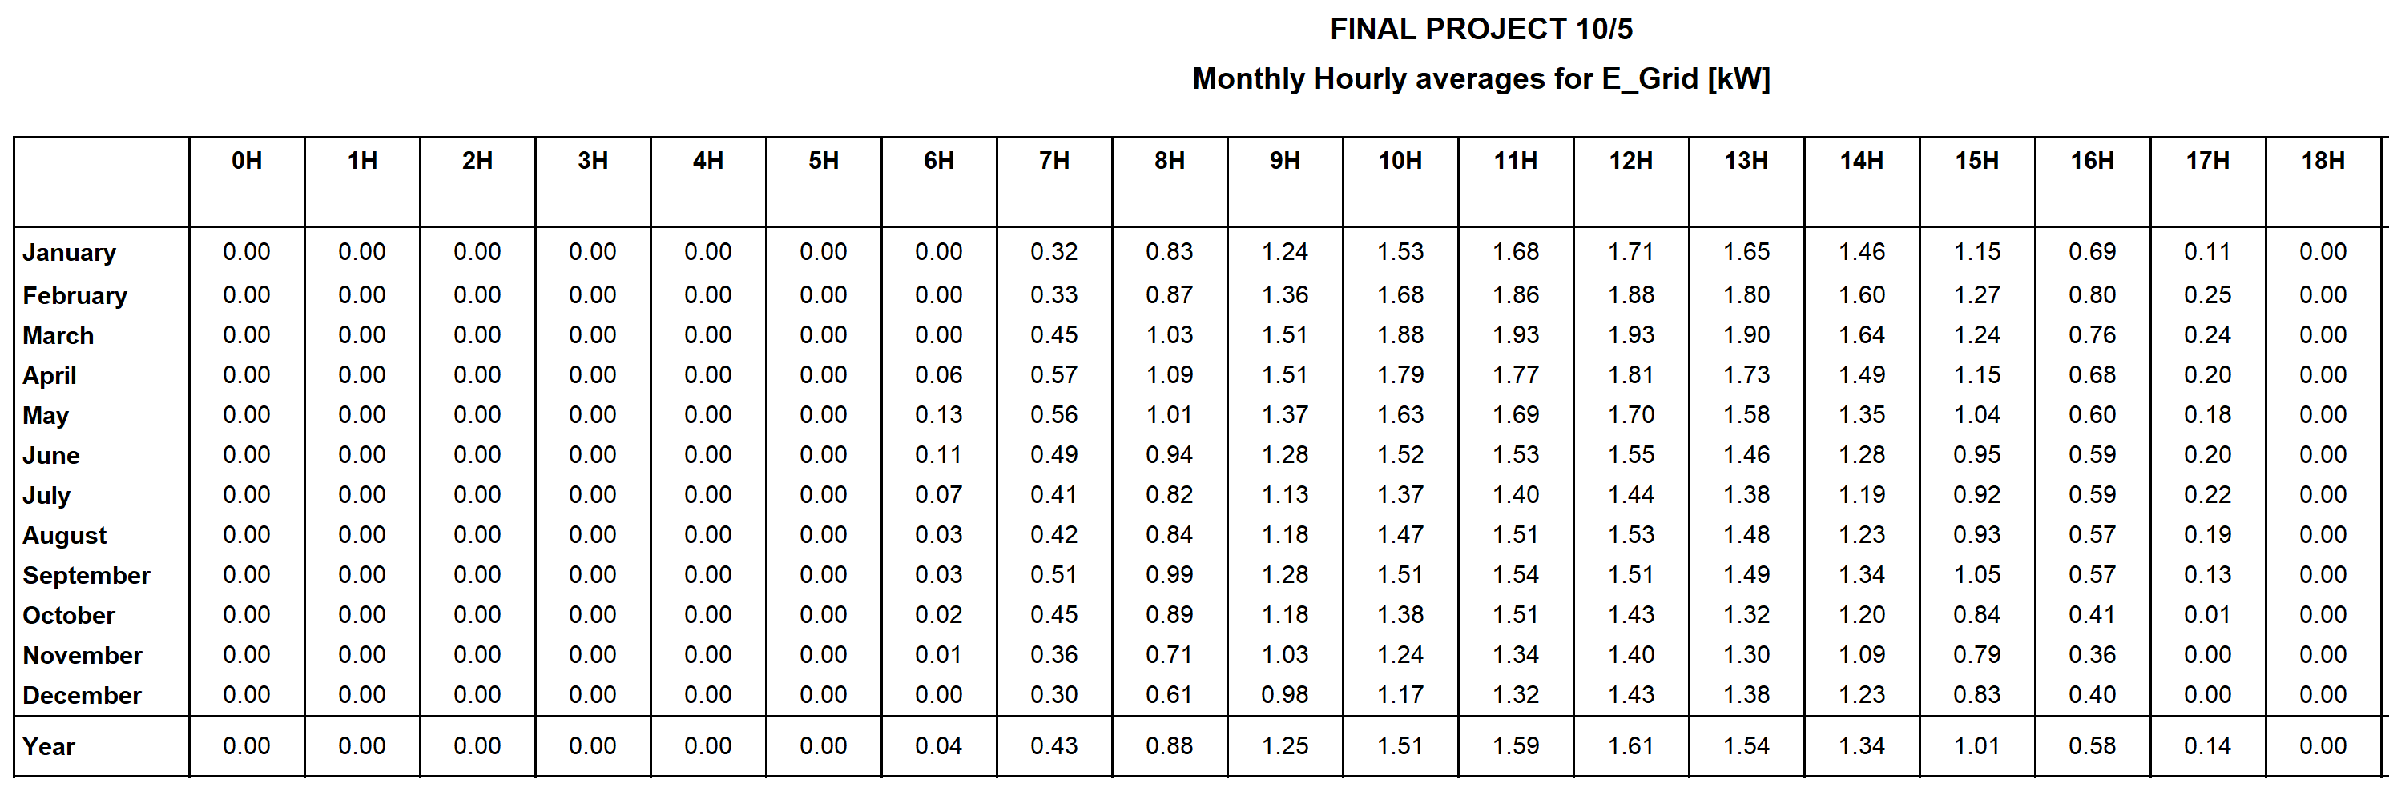
Simulation Results and Graphs

Slide 26
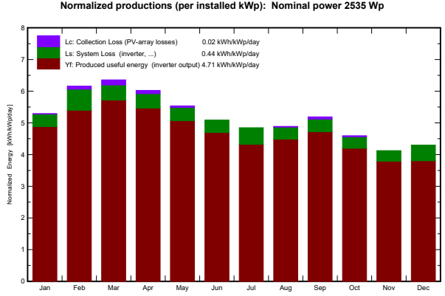
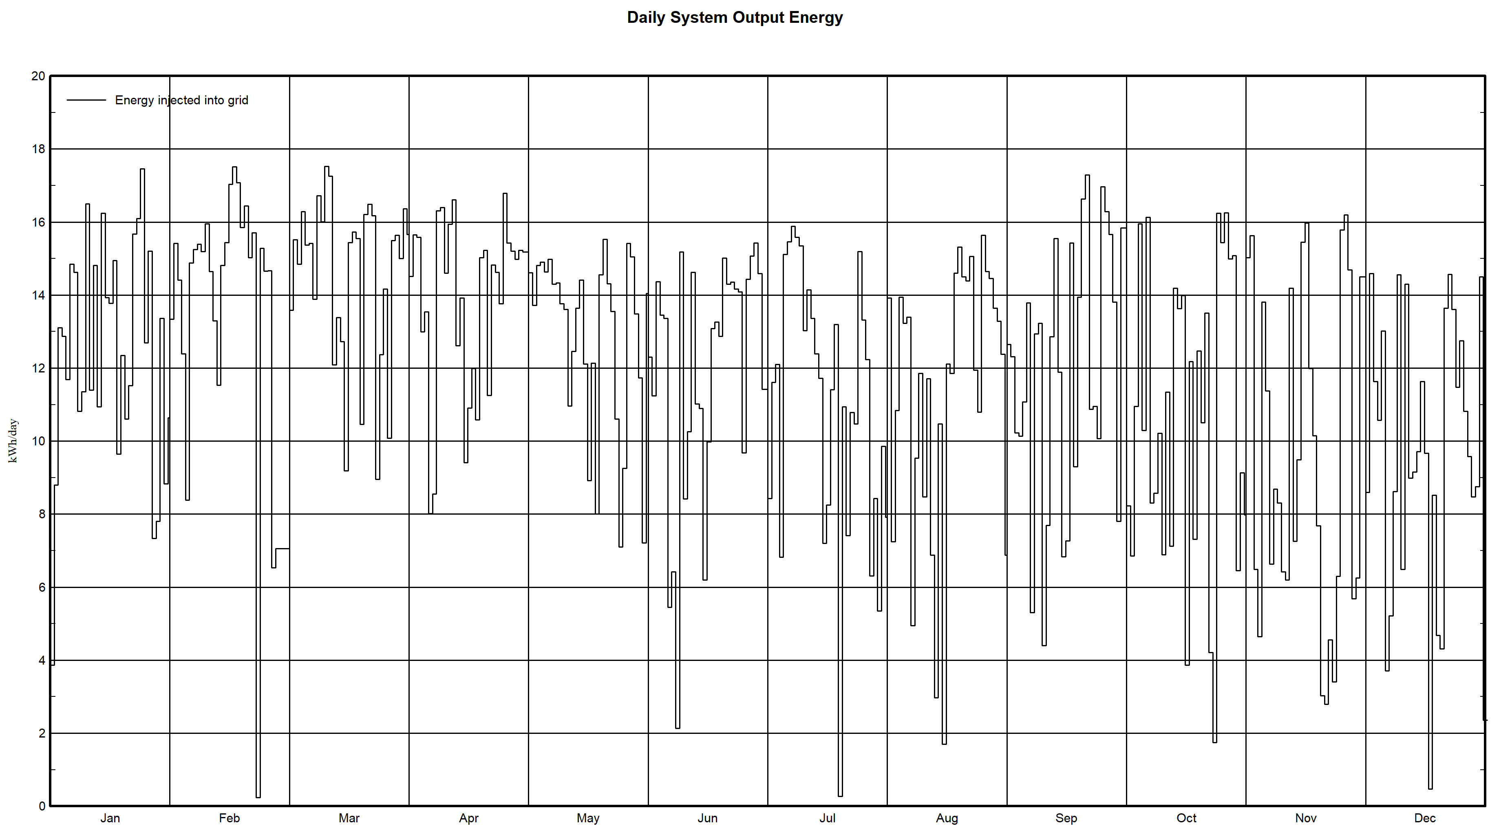
Simulation Results and Graphs

Slide 27
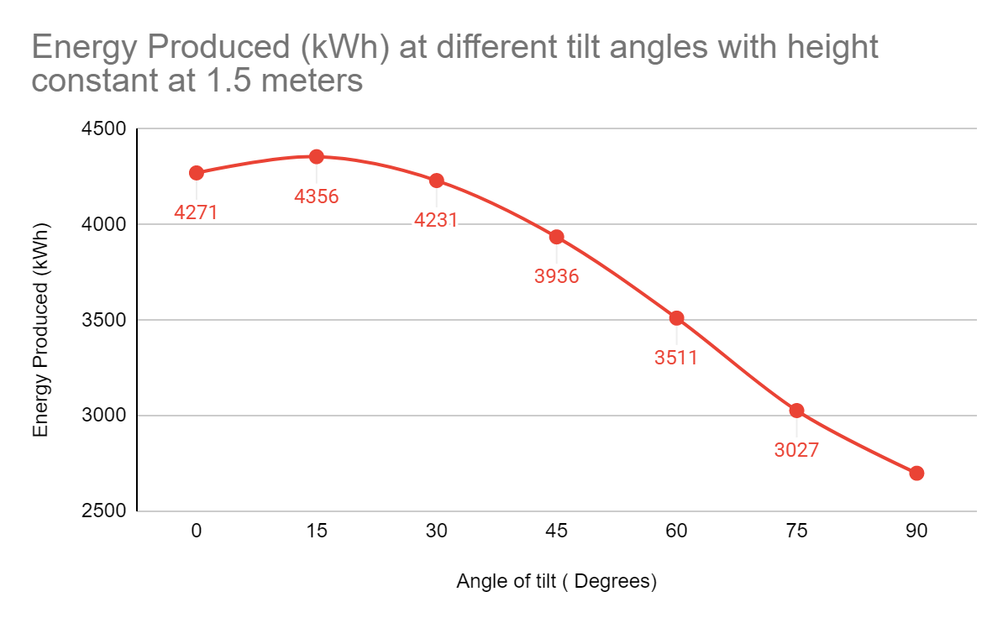
Simulation Results and Graphs
Energy produced at different angles for a constant height of 1.5M

Slide 28
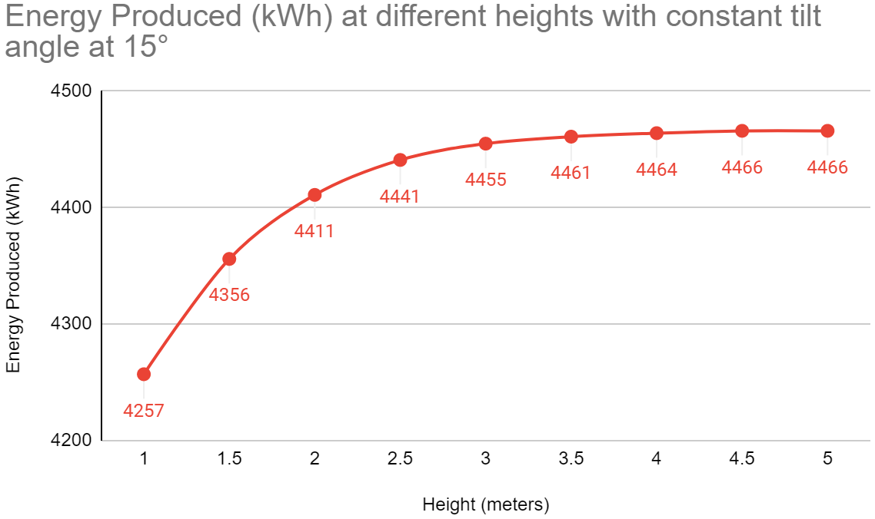
Simulation Results and Graphs
Energy produced at different heights for a constant angle of 15 degrees

Slide 29
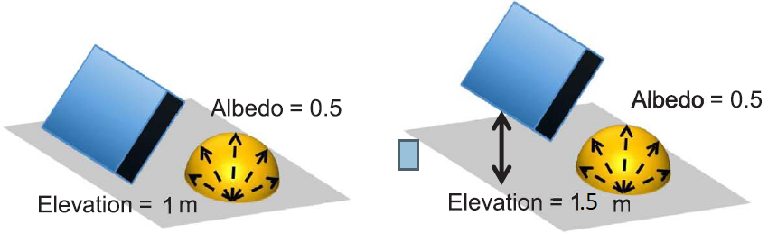
Conclusion and Optimal conditions taken from simulation
From the above performed simulation, mathematical model and analysis. We were able to infer that the best angle for our location at Chennai will be at optimum 15 degrees.
The tilt angle of 15° gives the maximum output because this angle is the closest to the latitude of the location which is 13.0827° N.
And further increase the output of the panel by increasing the height of the panel with respect to the ground at height of 1 meter and 1.5 meter.
By doing this we can tell the uniformity of the light that falls on the rear side of the panel increases with increase in height and thus improving the energy production.

Slide 30
Conclusion and Optimal conditions taken from simulation
The increase in output in energy from 1 meter to 1.5 meter was quite noticeable in both mathematical as well as the simulation. Whereas the increase from 1.5 meters or from 2 meters to 2.5 meters was not large but it was still significant if seen for year around production.
But any increase in height of above 2.5 meters does not produce any much increase in output level that will justify its cost for the structure.
It also has to be noted that with increase in height, wind force experienced by the panel increases as it moves away from the ground.
This increases the cost of the setup and will not justify the performance to cost ratio.

Slide 31
References
Min Hsian Saw, Yong Sheng Khoo, Jai Prakash Singh, and Yan Wang. "Enhancing optical performance of bifacial PV modules", Energy Procedia 124 (2017): 484-494.
Wenbo Gu, Senji Li, Xing Liu, Zhenwu Chen, Xiaochun Zhang, and Tao Ma. "Experimental investigation of the bifacial photovoltaic module under real conditions”, Renewable Energy (2020).
Xingshu Sun, Mohammad Ryyan Khan, Chris Deline, and Muhammad Ashraful Alam. "Optimization and performance of bifacial solar modules: A global perspective”, Applied energy 212 (2018): 1601-1610.

Slide 32
References
Stanley Wang, Oscar Wilkie, Jenny Lam, Rob Steeman, Wilson Zhang, Kah Sing Khoo, Sim Chun Siong, and Hannes Rostan. "Bifacial photovoltaic systems energy yield modelling", Energy Procedia 77 (2015): 428-433.
Ismail Shoukry, Joris Libal, Radovan Kopecek, Eckard Wefringhaus, and Jürgen Werner. "Modelling of bifacial gain for stand-alone and in-field installed bifacial PV modules", Energy Procedia 92 (2016): 600-608.
Enric Grau Luque, Fernando Antonanzas-Torres, and Rodrigo Escobar. "Effect of soiling in bifacial PV modules and cleaning schedule optimization", Energy Conversion and Management 174 (2018): 615-625.
Judith Frank, Marc Rüdiger, Stefan Fischer, Jan Christoph Goldschmidt, and Martin Hermle. "Optical simulation of bifacial solar cells", Energy Procedia 27 (2012): 300-305.

Slide 33
References
Raina Gautam, and Sunanda Sinha. "A simulation study to evaluate and compare monofacial Vs bifacial PERC PV cells and the effect of albedo on bifacial performance." Materials Today: Proceedings (2020).
Katsaounis, Th, K. Kotsovos, Issam Gereige, A. Basaheeh, M. Abdullah, A. Khayat, E. Al-Habshi, A. Al-Saggaf, and A. E. Tzavaras. "Performance assessment of bifacial c-Si PV modules through device simulations and outdoor measurements." Renewable Energy 143 (2019): 1285-1298.
Nussbaumer, Hartmut, Markus Klenk, Marco Morf, and Nicolas Keller. "Energy yield prediction of a bifacial PV system with a miniaturized test array." Solar Energy 179 (2019): 316-325.
Patel, M. Tahir, Ramachandran A. Vijayan, Reza Asadpour, M. Varadharajaperumal, M. Ryyan Khan, and Muhammad A. Alam. "Temperature-dependent energy gain of bifacial PV farms: A global perspective." Applied Energy 276 (2020): 115405.

Slide 34
References
Baumann, Thomas, Hartmut Nussbaumer, Markus Klenk, Andreas Dreisiebner, Fabian Carigiet, and Franz Baumgartner. "Photovoltaic systems with vertically mounted bifacial PV modules in combination with green roofs." Solar Energy 190 (2019): 139-146..
Zhu, Qiangzhong, Chen Zhu, Songmin Liu, Chanjun Shen, Wei Zhao, Zhenbo Chen, Ling Chen et al. "A model to evaluate the effect of shading objects on the energy yield gain of bifacial modules." Solar Energy 179 (2019): 24-29.
Chudinzow, Dimitrij, Jannik Haas, Gustavo Díaz-Ferrán, Simón Moreno-Leiva, and Ludger Eltrop. "Simulating the energy yield of a bifacial photovoltaic power plant." Solar Energy 183 (2019): 812-822.
Stanley Wang, Oscar Wilkie, Jenny Lam, Rob Steeman, Wilson Zhang, Kah Sing, Khoo, Sim Chun Siong, Hannes Rostan. “Bifacial photovoltaic systems energy yield modelling”, Energy Procedia 77 ( 2015 ) 428-433.

Slide 35
References
Ismail Shoukry, Joris Libal, Radovan Kopecek, Eckard Wefringhaus, Jürgen Werner, “Modelling of bifacial gain for stand-alone and in-field installed bifacial PV modules”, Energy Procedia 92 ( 2016 ) 600-608
Ahmer A.B. Baloch, Said Hammat, Benjamin Figgis, Fahhad H. Alharbi, Nouar Tabet, “In-field characterization of key performance parameters for bifacial photovoltaic installation in a desert climate”, Renewable Energy, 159 (2020) 50-63.
Wenhao Chena, Renzhong Liub, Qingguo Zenga, Lang Zhoua, “Low cost multicrystalline bifacial PERC solar cells – Fabrication and thermal improvement”, Solar Energy, 184 (2019) 508-514.
Gu, Wenbo, Tao Ma, Meng Li, Lu Shen, and Yijie Zhang. "A coupled optical-electrical-thermal model of the bifacial photovoltaic module." Applied Energy 258 (2020): 114075.

